Slide 1
Data Storytelling Project
Deck of 6 unique visualisations
Subject –
Data Handling and Visualisation
Made by –
Ved Bhatt (J009)
Aditya Das (J016)
Rishi Gandhi (J022)
Suchetan Ghosh (J024)

Slide 2
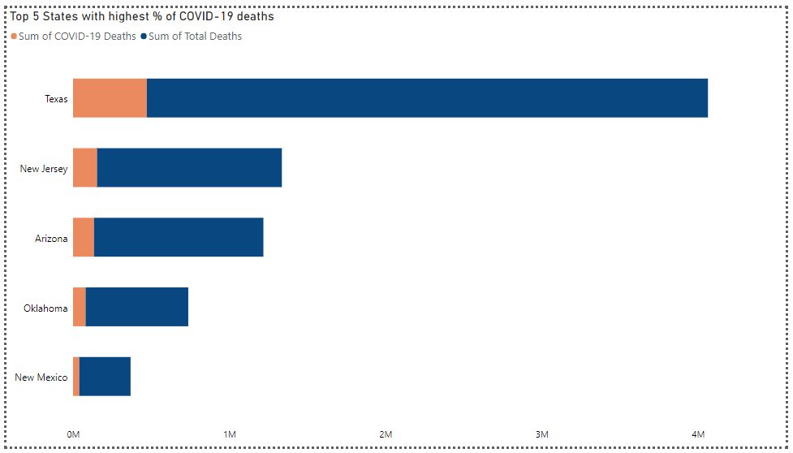
Stacked Bar Chart showcasing the top 5 states where COVID-19 contributed the most in total deaths.

Slide 3
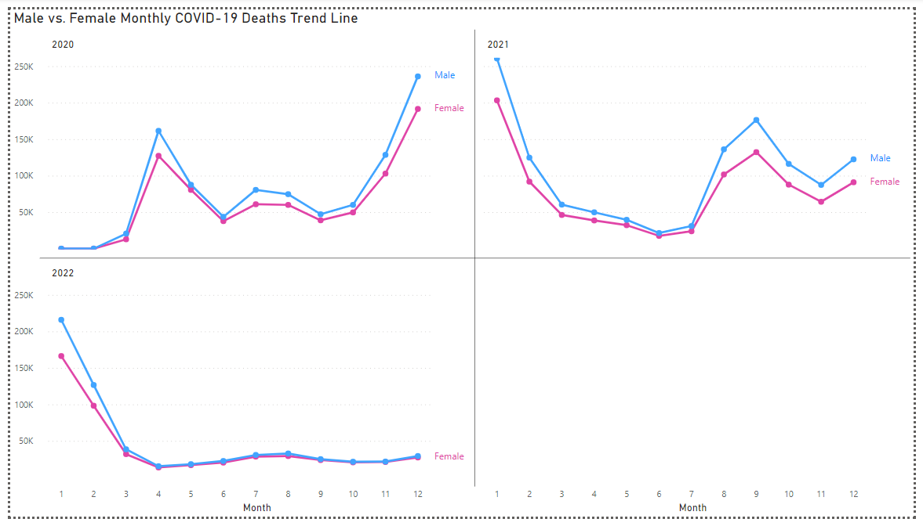
Line Charts showing the monthly data for male and female deaths caused by COVID-19 for all 3 years of 2020, 2021 and 2022.

Slide 4
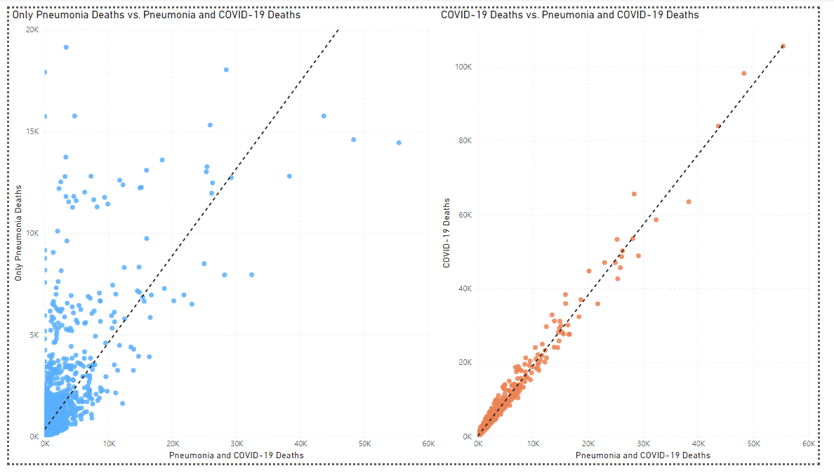
Two scatter plots comparing the relationship of deaths caused by Pneumonia and deaths caused by COVID-19 with deaths caused by both Pneumonia and COVID-19.

Slide 5
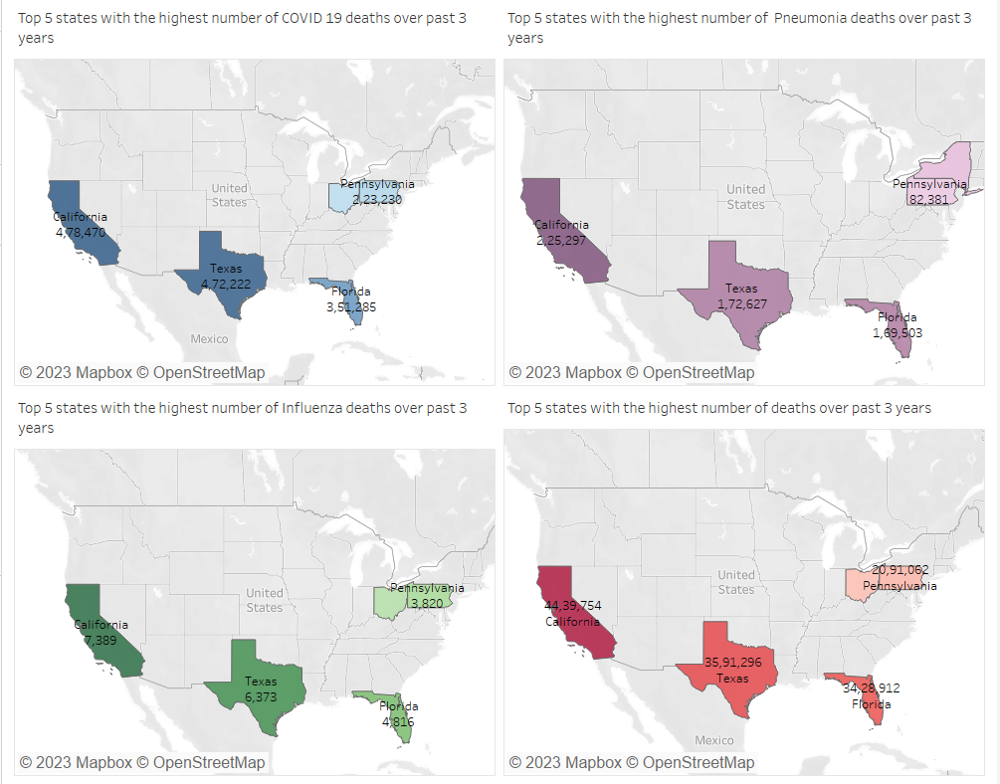
Filled Maps highlighting the top 5 states with the highest number of deaths from 2020 to 2022, caused by COVID-19 (blue), Pneumonia (purple), Influenza (green), and finally, total number of deaths over past 3 years (red).

Slide 6
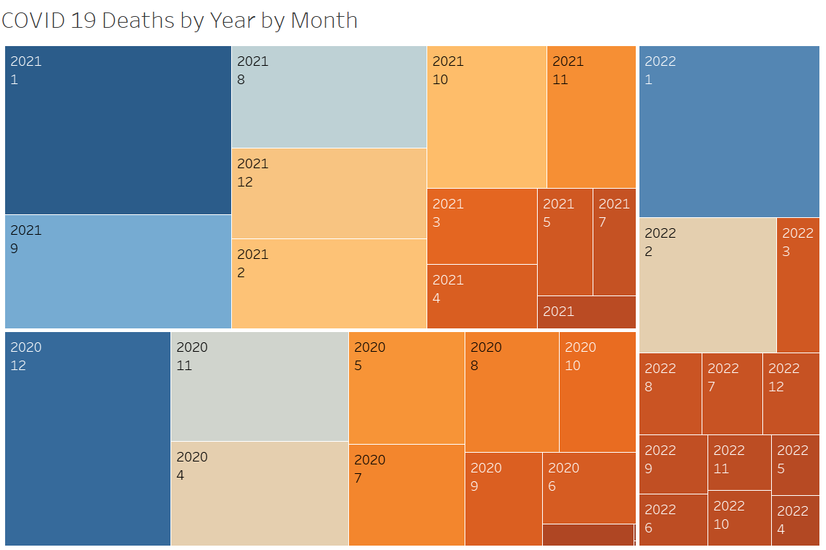
Tree Map showing the hierarchy of the months of each year from 2020 to 2022, based on the number of deaths caused by COVID-19.

Slide 7
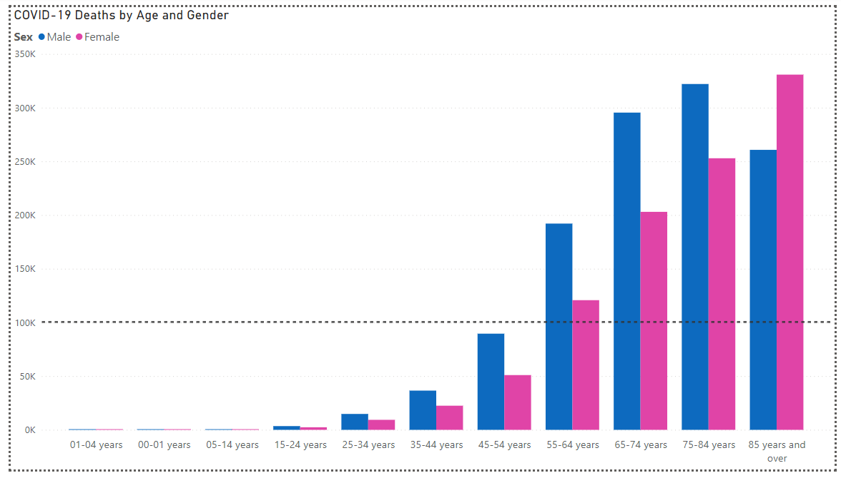
A clustered bar chart visualising the number of COVID-19 deaths of males and females over different age groups.

